Slide 1


Slide 2
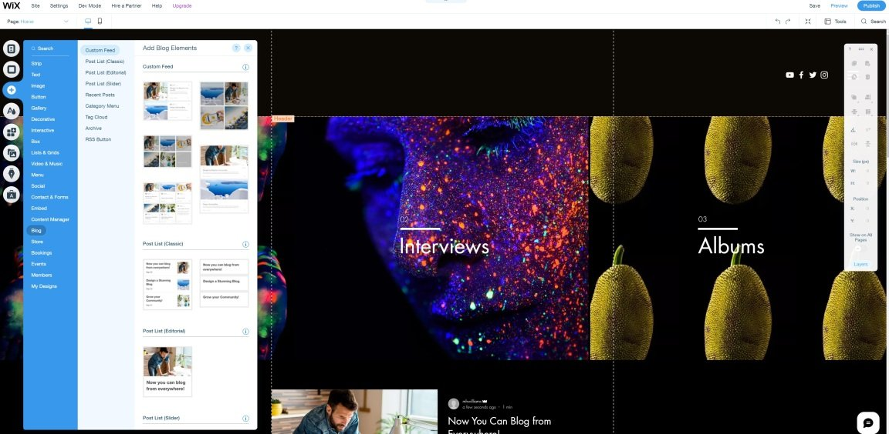
If you want to build a website online with minimal effort and maximum creative freedom, look no further than Wix. It offers standout features, such as online storage for your site assets, e-commerce tools, cool video backgrounds, title animations etc.

Slide 3
How To Work With Wix?
Wix is a website builder, an easy-to-use tool that lets you quickly create an online presence via a drag-and-drop interface, no coding knowledge is required. All you need is an email address.
After creating an account, you search for a general site type business, designer, event, blog, and so on and then choose whether you want to use a site template or have Wix automatically create a site for you using Artificial Design Intelligence (ADI)

Slide 4
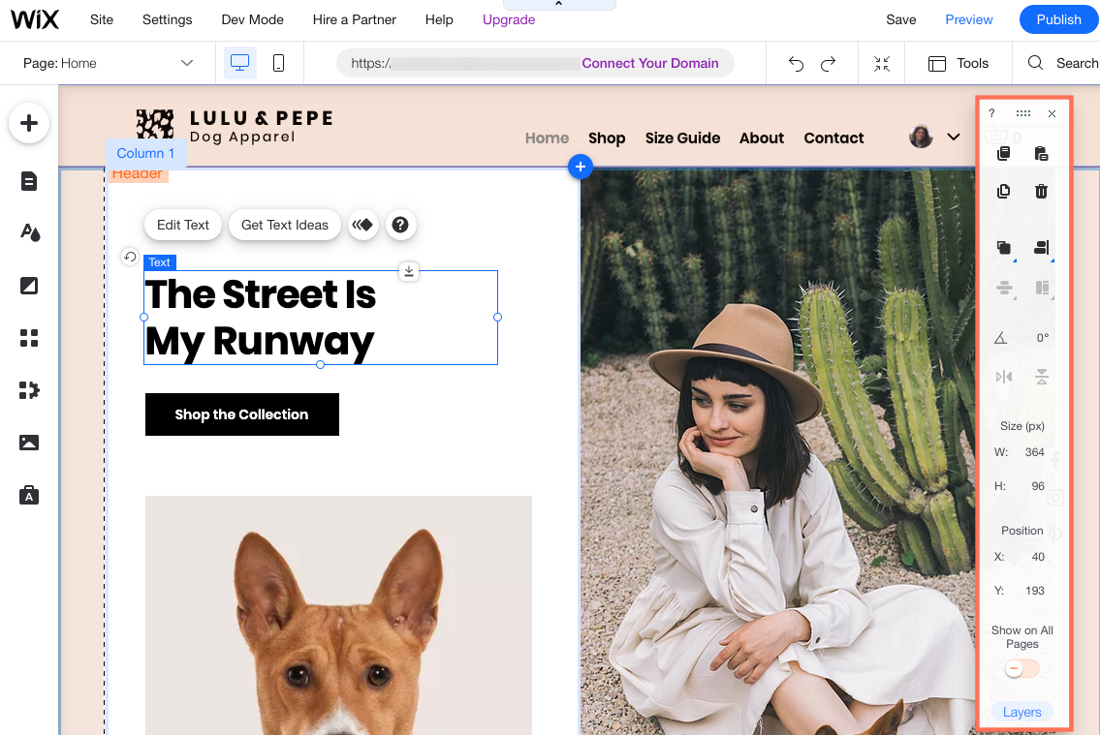
Wix Editor is a platform that you can use to create and edit your own sites. It employees innovative drag and drop technology which allows you to easily add or change elements on your site and has many design options.

Slide 5
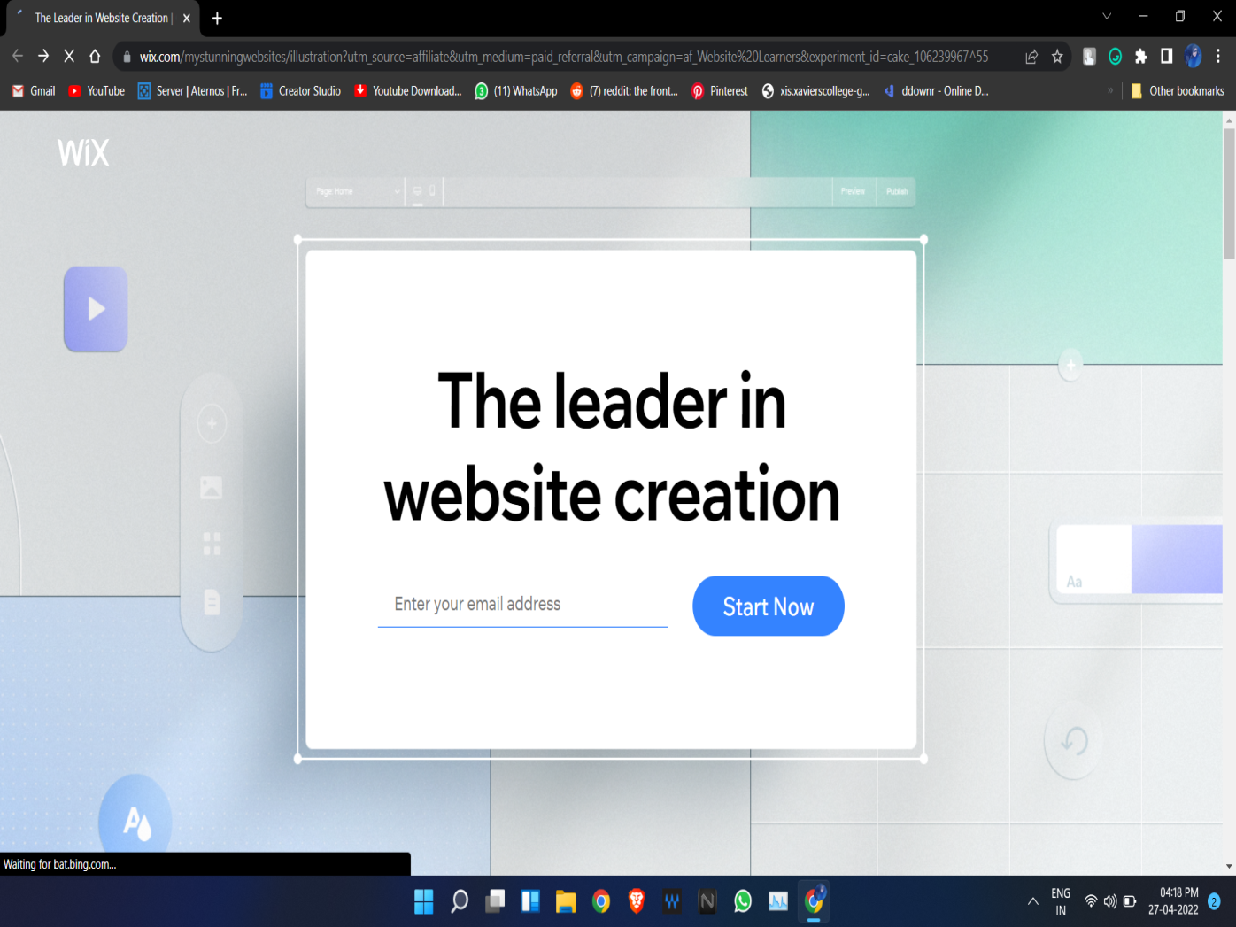
Setting up WIX account
First you need to open this link https://wl.tools/wix on your web browser.
Then click on start now to create an account

Slide 6
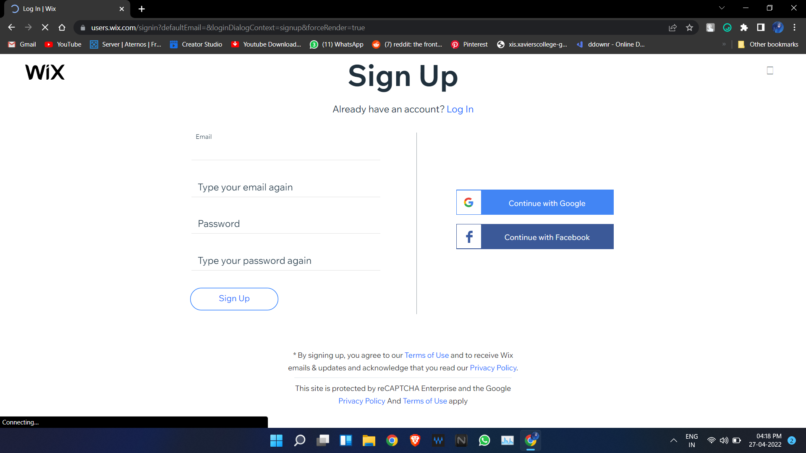
Setting up WIX account
Then just fill up all your details and click on sign up.
Or you can also sign up using Google or Facebook account

Slide 7
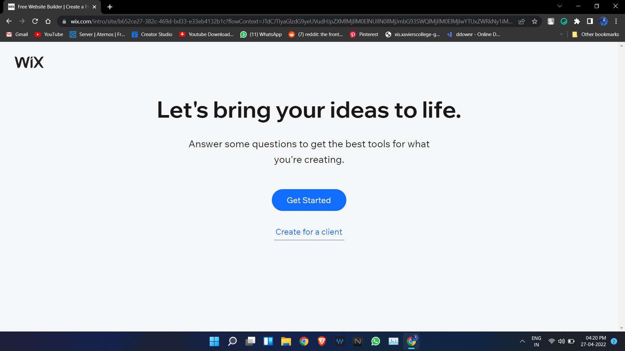
Setting up WIX account
And then your account will be created.

Slide 8
Laying Out Pages Using Template Features

Slide 9
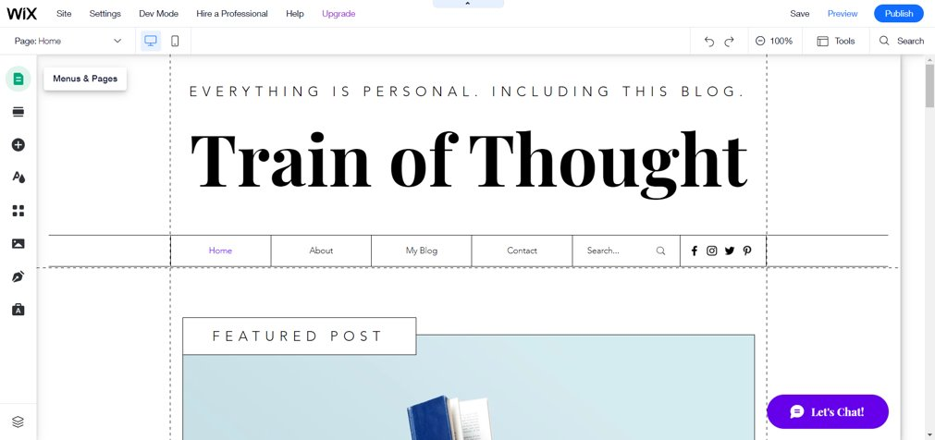
To add pages to the site click on Menus & Pages

Slide 10
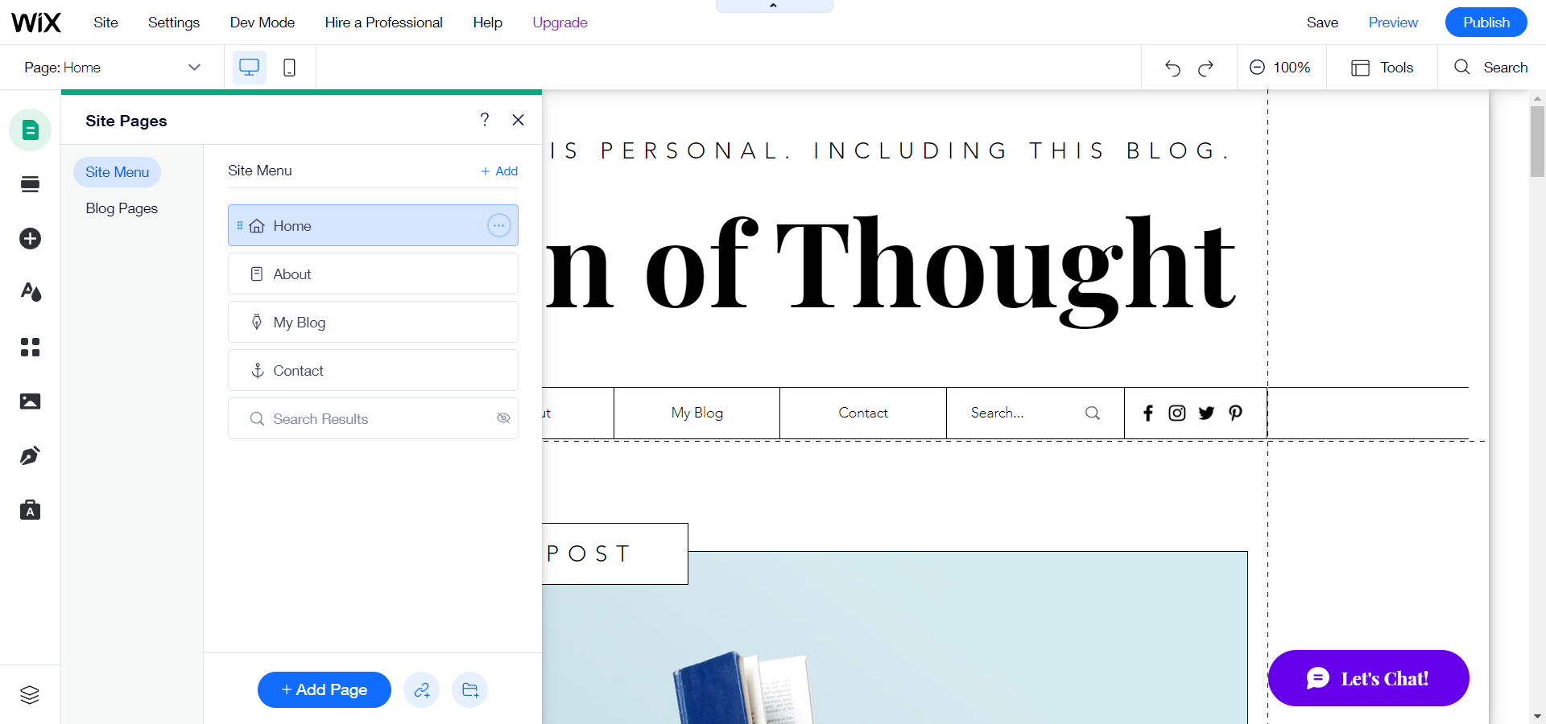
Then select where you want to add the page and click on + Add Page

Slide 11
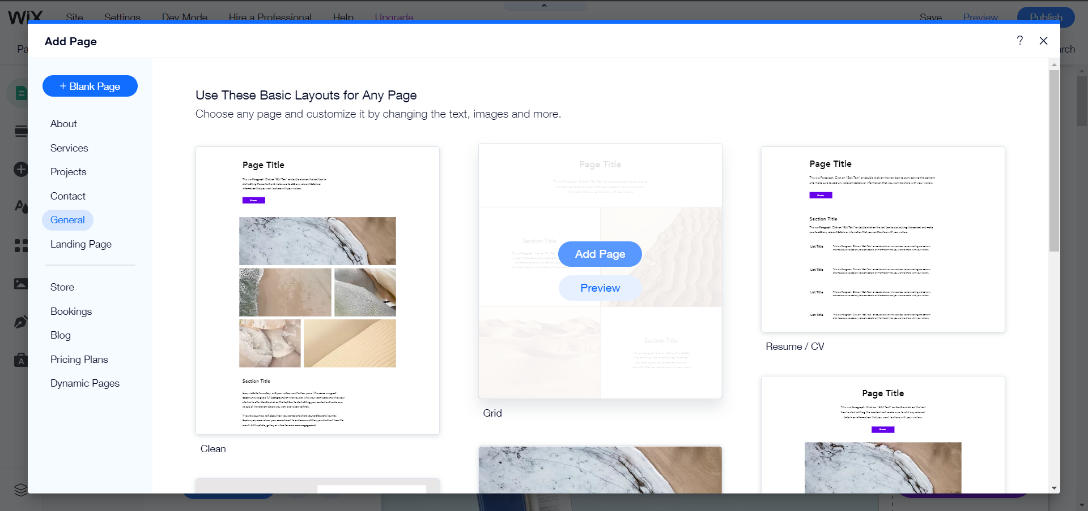
Then select a page from the available templates and click on Add Page.

Slide 12
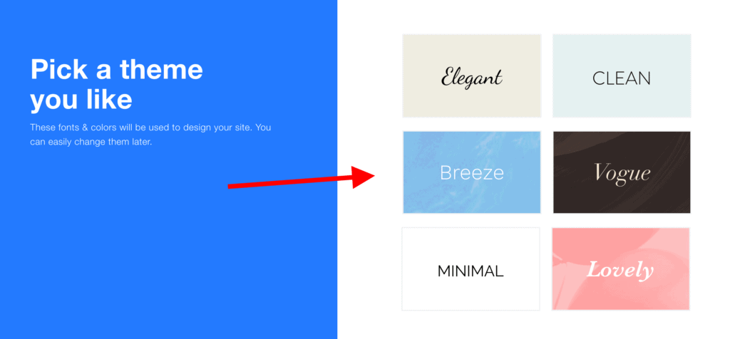
Choose a Template (Design)
Wix tries to make the design selection process as straightforward as possible, so instead of showing you a wall of hundreds of templates to choose from, it begins by asking just about the style of design that you prefer.

Slide 13
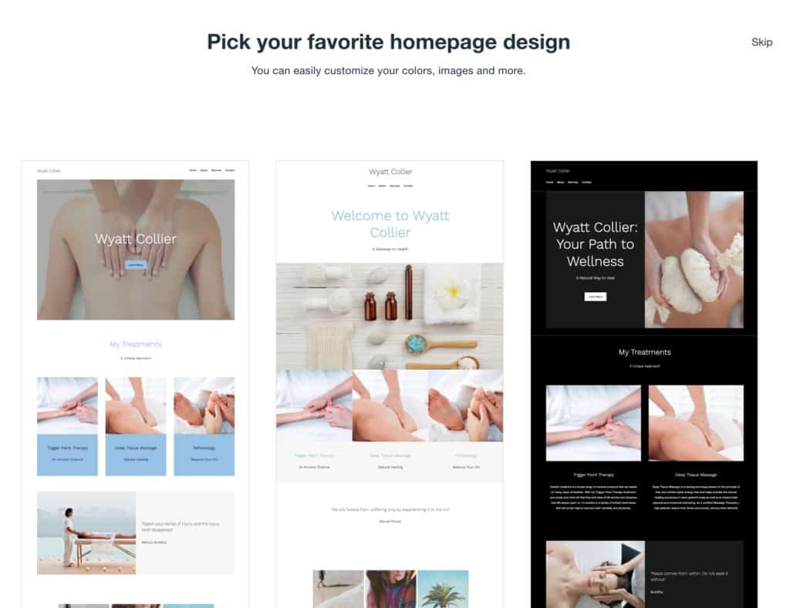
We choose a template called breeze.
As soon as you make a choice, you’ll see that Wix puts together pretty accurate homepage alternatives to pick from. Based on your previous selections, these homepages will be pre-filled with relevant graphics and adhere to a given design style.

Slide 14
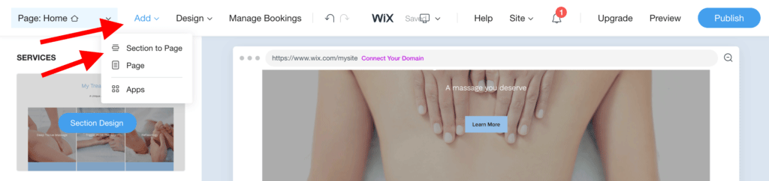
Adding New Sections
you can add new sections . To do so, click on the Add button that’s in the top menu, and then click on “Section to Page.”

Slide 15
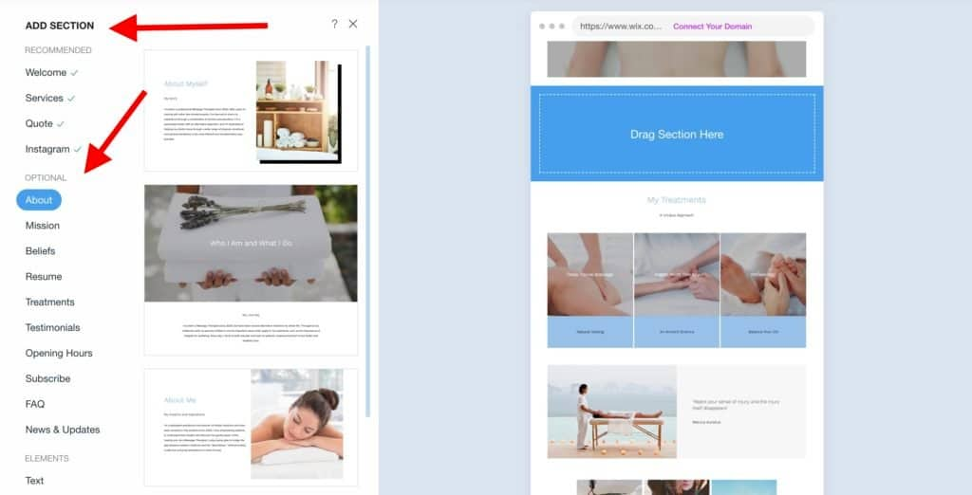
You’ll see that there’s really a lot of different content sections to pick from. sections come pre-categorized:
You can grab any section from the sidebar and drag-and-drop it onto the canvas to the right.

Slide 16
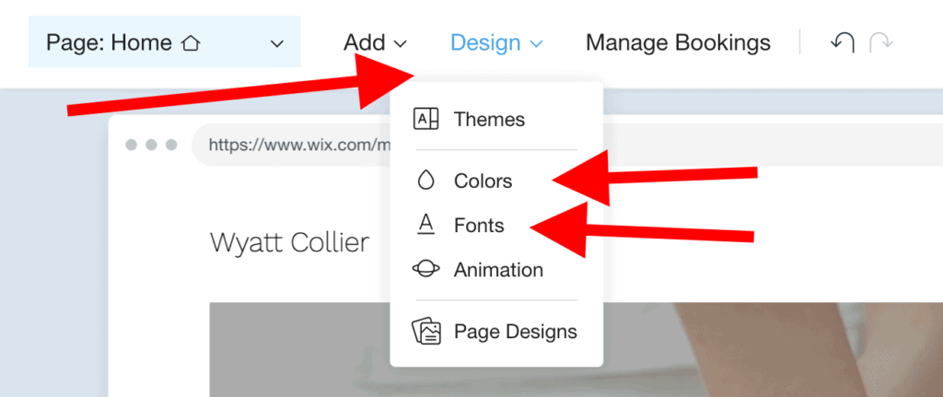
Setting Fonts And Colors
When you get started with the Wix ADI editor, you’ll get a pre-defined color scheme and font settings.
you can change them easily to get a more fine-tuned look.
To do so, click on the Design button in the top menu and then on Colors.

Slide 17
The same thing goes for your fonts. Start with the same Design button in the top menu, and select Fonts.

Slide 18
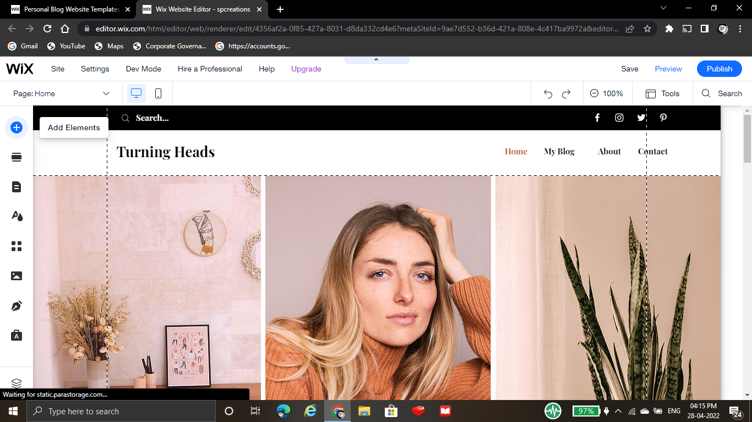
Adding Site Content Features
Open the Add panel and click Add Elements + on the left of
the editor

Slide 19
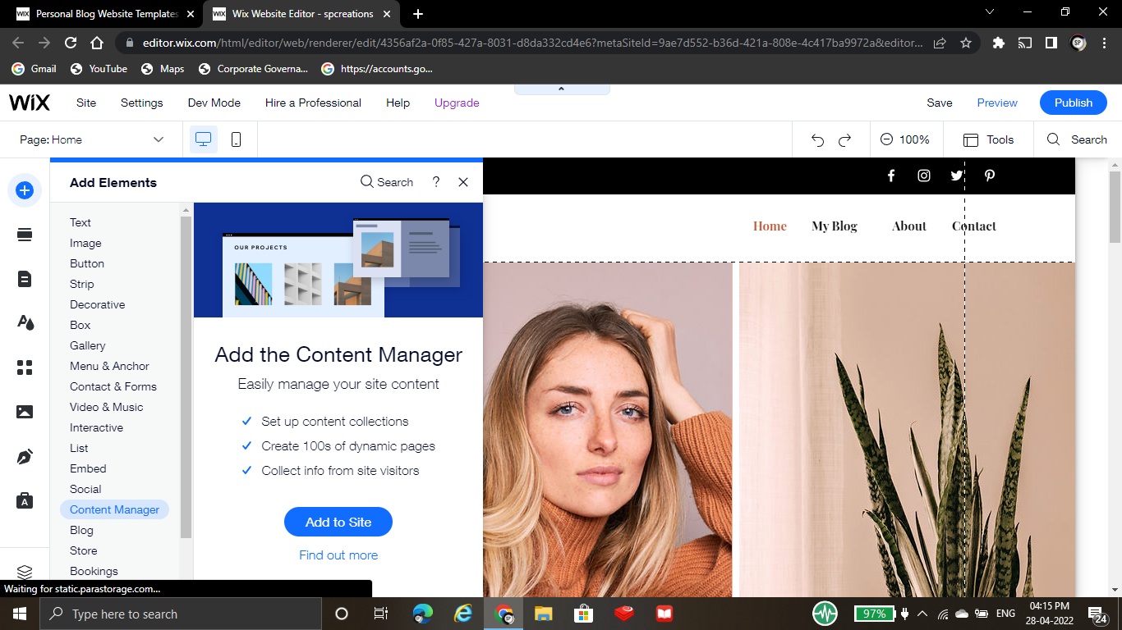
Adding Site Content Features
Click Content Manager.

Slide 20
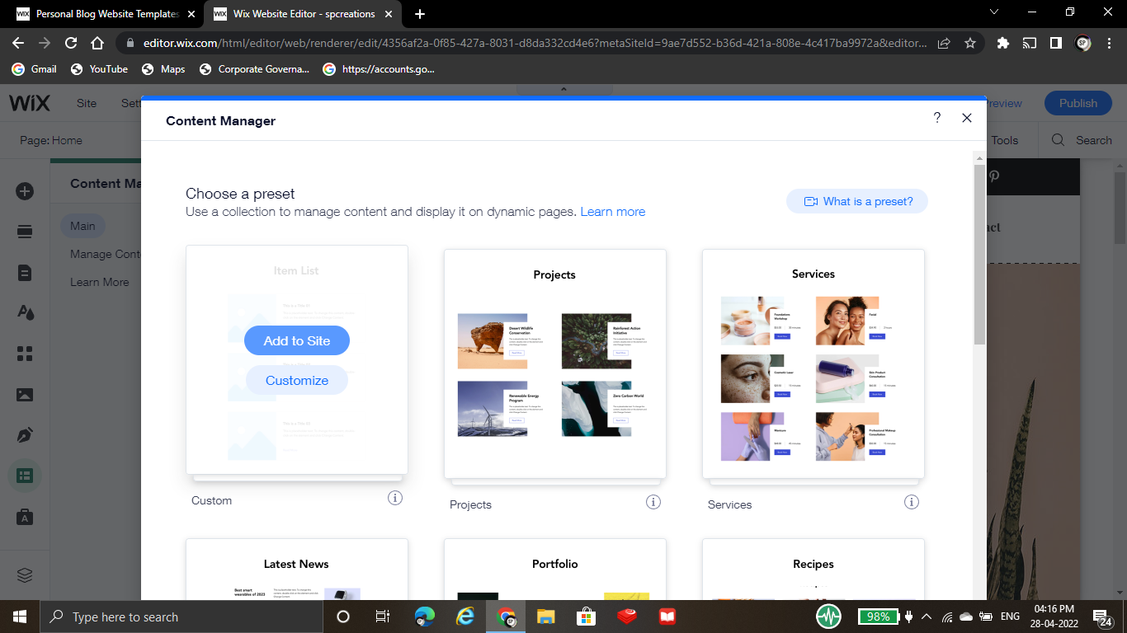
Adding Site Content Features
Select a preset or click Custom to start from scratch.

Slide 21
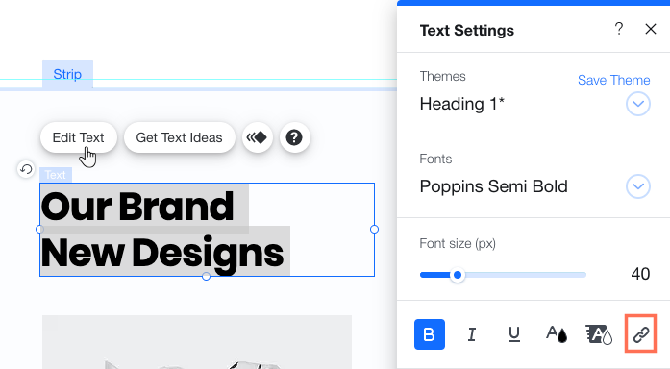
Adding A Link To Text
Add links to text from the text settings panel. You can link to an entire text block, or just specific parts. Some popular text links include "Read More" or "Buy Now".
To link text:
Click the text element in your Editor.
Click Edit Text.
Highlight the relevant text.
Click the Link icon .
Select a link type. and enter the link details.
Click Done.

Slide 22
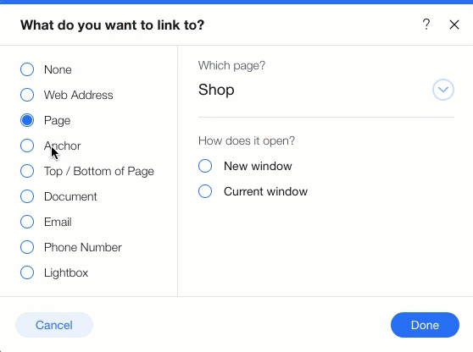
Types Of Links
There are a many types of links you can add to your elements to direct your site visitors to whatever content you like; including links to lightboxes, anchors, and external URLS.

Slide 23
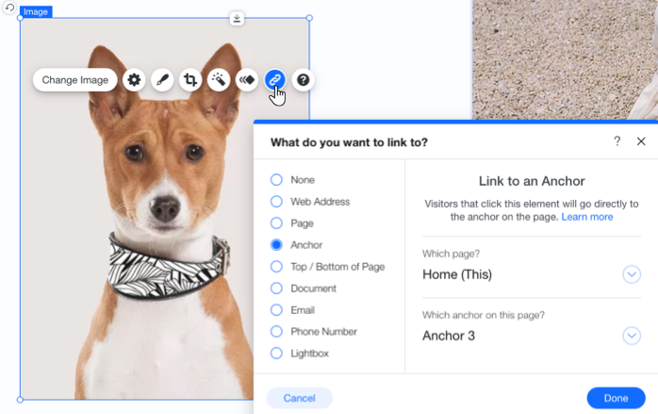
Adding A Link To An Element
Add links to a variety of elements including images, buttons, and vector art.
To add a link to an element:
Click the Link icon .
Select the link type and enter the details.
Click Done

Slide 24
Adding A Link To Your Menu
Your site menu contains items that link to pages or page sections on your site. However, you can also link a menu item to another destination.
These links look like regular menu items, and you can name them whatever you like.
To link a menu item:
1. Click Menus & Pages on the left side of the Editor
2.Click the Add a Link icon .
Select the link type and enter the link details.
Choose whether your link opens in a new window or the current window.
Click Done.
Enter the name for the menu item.

Slide 25
Tune-Up Your Site For Mobile Devices
These days, mobile phones are often people’s primary devices for accessing the web.
In fact, more people use mobiles than desktops and laptops combined.
You absolutely must make sure that your website looks properly on mobile! If you fail at that, people will leave and probably never come back.
Moreover, if you happen to be running a local business, the impact of mobile is even bigger.
Various “near me” searches make up a big chunk of the overall local traffic on Google, and being able to serve those users quickly is of utmost importance if you want to earn their business.
For instance, imagine you running the aforementioned massage parlor. If someone searches “massage near me” and your site comes up but it fails to load on their phone, then that would-be customer will not come to you.

Slide 26
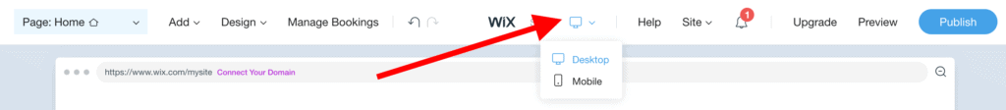
Getting your site mobile-optimized with Wix is easy. To begin, click on the view switcher button that’s in the top bar. This one:
This will reload the page and show you how it’s going to appear on mobile devices.

Slide 27
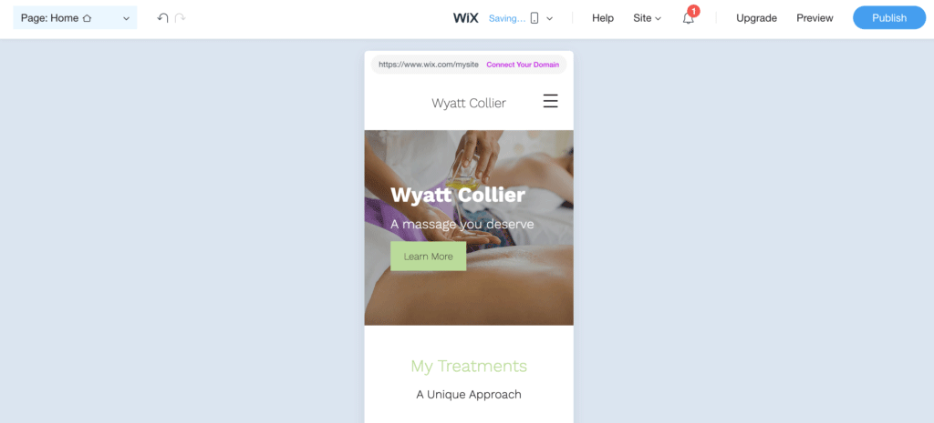

Slide 28
Most crucially, any changes you make here won’t affect the way your site looks on the desktop. This is mobile-only!
Here’s what you can do that’s generally going to make your site better on mobile:
hide images that aren’t crucial and just take up space on the mobile view
put your contact info higher up on the page – people want to get to that quickly
highlight only your main product or service
Wix lets you customize really a lot here regarding hiding different elements on the page, realigning entire sections, and so on.
When you’re done, just switch to desktop view again. Your changes will be saved automatically.

Slide 29
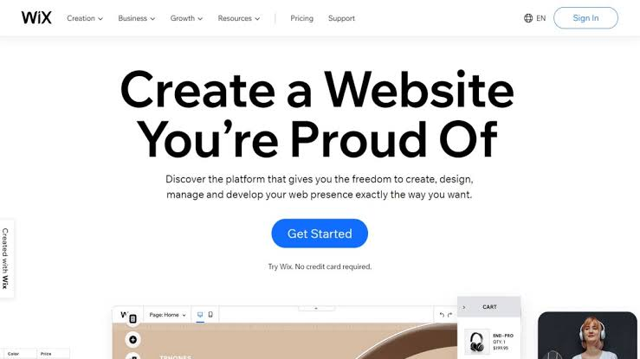
CMS Development Using WIX
Wix provides a quick and easy platform to design a website for your business with little to no techincal experience.
Wix also maintains the site, fixing any security or other problems that might emerge.
An additional benefit is the low cost of getting started

Slide 30
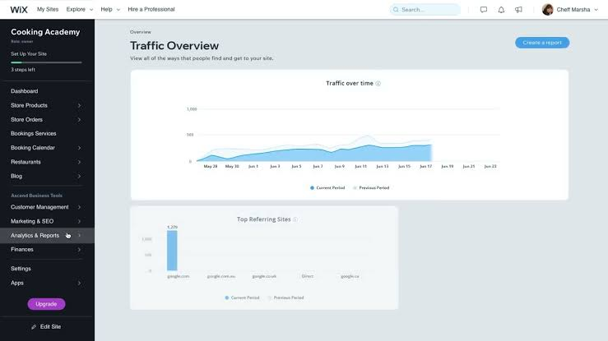
CMS Development Using WIX
WIX is a website builder. It is intended to make creating a website quick and easy.
That means it doesn’t require any knowledge of coding and is made specifically for people with minimal web experience.
You can build a website for free.

Slide 31
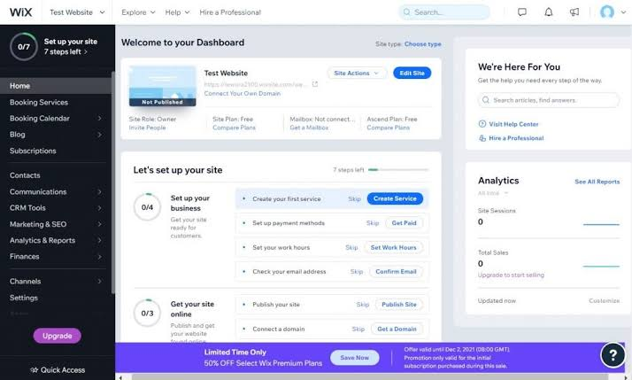
CMS Development Using WIX
It’s probably best suited to small businesses, which don’t intend to grow exponentially.
It provides various website templates, with handy drag and drop designs to fill in with your business’s content. All of this makes web designing quick.

Slide 32
References
https://support.wix.com/en/article/adding-the-content-manager-to -your-site
www.wix.com
https://youtu.be/4UuwYco8K7c
www.rfdmsolutions.com
https://www.wix.com/blog/2021/02/how--to-make-a-website/
https://websitesetup.org/how-to-use-wix-editor/

Slide 33
THANKYOU

